Slide 1
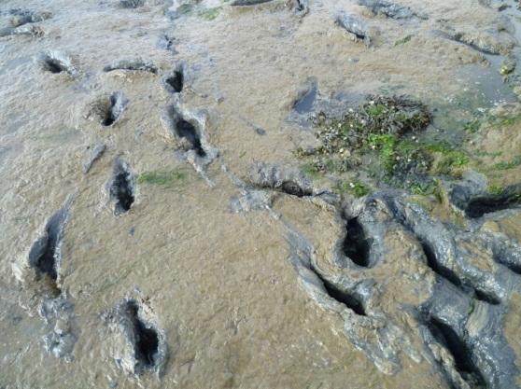
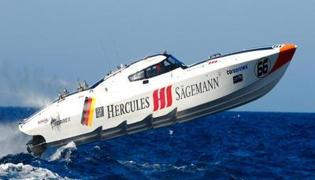
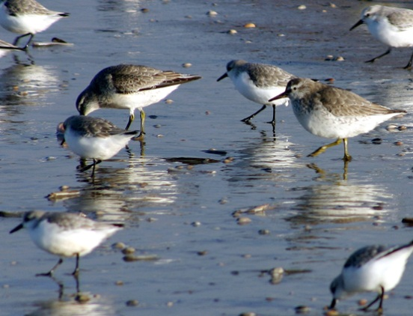
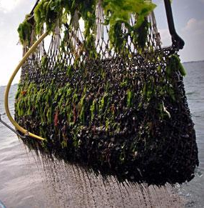
Which cumulative effects? Effect assessments at science-policy boundaries
Judith Floor, 1 July 2016

Slide 2
Outline
Significant effect at the science-policy boundary
2 case studies
Mussel seed fishery
Powerboat race
The political aspects of cumulative effects

Slide 3
Significant (cumulative) effects
“Any plan or project not directly connected with or necessary to the management of the site but likely to have a significant effect thereon, either individually or in combination with other plans or projects, shall be subject to appropriate assessment of its implications for the site in view of the site's conservation objectives” (article 6.3, Habitat Directive 92/43/EEC)

Slide 4
Significant (cumulative) effects
Controversies over what is allowed in nature areas have transformed in disputes over the assessment of significant effect

Slide 5
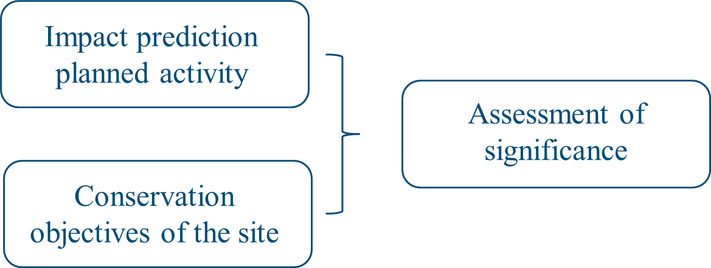
Appropriate assessments
Effect assessment: knowledge of what will probably happen is combined with a value judgement on what is allowable

Slide 6
Science-policy boundaries

Slide 7
Boundary object
Significant effect assessment

Slide 8
Discourse coalitions
Policy domain
Policy domain
Science domain
Science domain

Slide 9
Knowledge uncertainties
Authorities should only permit an activity if “no reasonable scientific doubt remains as to the absence of such effects” (ECJ 2004, paragraph 61)
Not knowing enough
Knowing differently
Incomplete knowledge
Unpredictability
Ambiguity

Slide 10
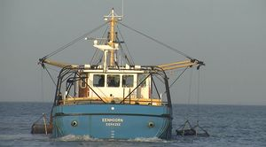
Spring 2006: permit for mussel seed fishery
Mussel seed fishery
No significant effect
Uncertainty of incomplete knowledge is addressed through monitoring
Mussel fishery belongs in the Wadden Sea
Possible significant effect
Uncertainty of incomplete knowledge on seabed effects Ambiguity on long-term effect
No damage to the seabed

Slide 11
Ambiguity on cumulative effects
Mussel seed fishery
Positive cumulative effect: Increase of mussel biomass in combination with mussel plots
Mussel fishery belongs in the Wadden Sea
Ambiguity on this assumption: Without fishery potentially more mussels
No damage to the seabed

Slide 12
Ambiguity on cumulative effects
Mussel seed fishery
No cumulative effects: Assessed for shrimp fishery
Mussel fishery belongs in the Wadden Sea
Possible cumulative effects: For eider ducks, effects of Ensis fishery
No damage to the seabed

Slide 13
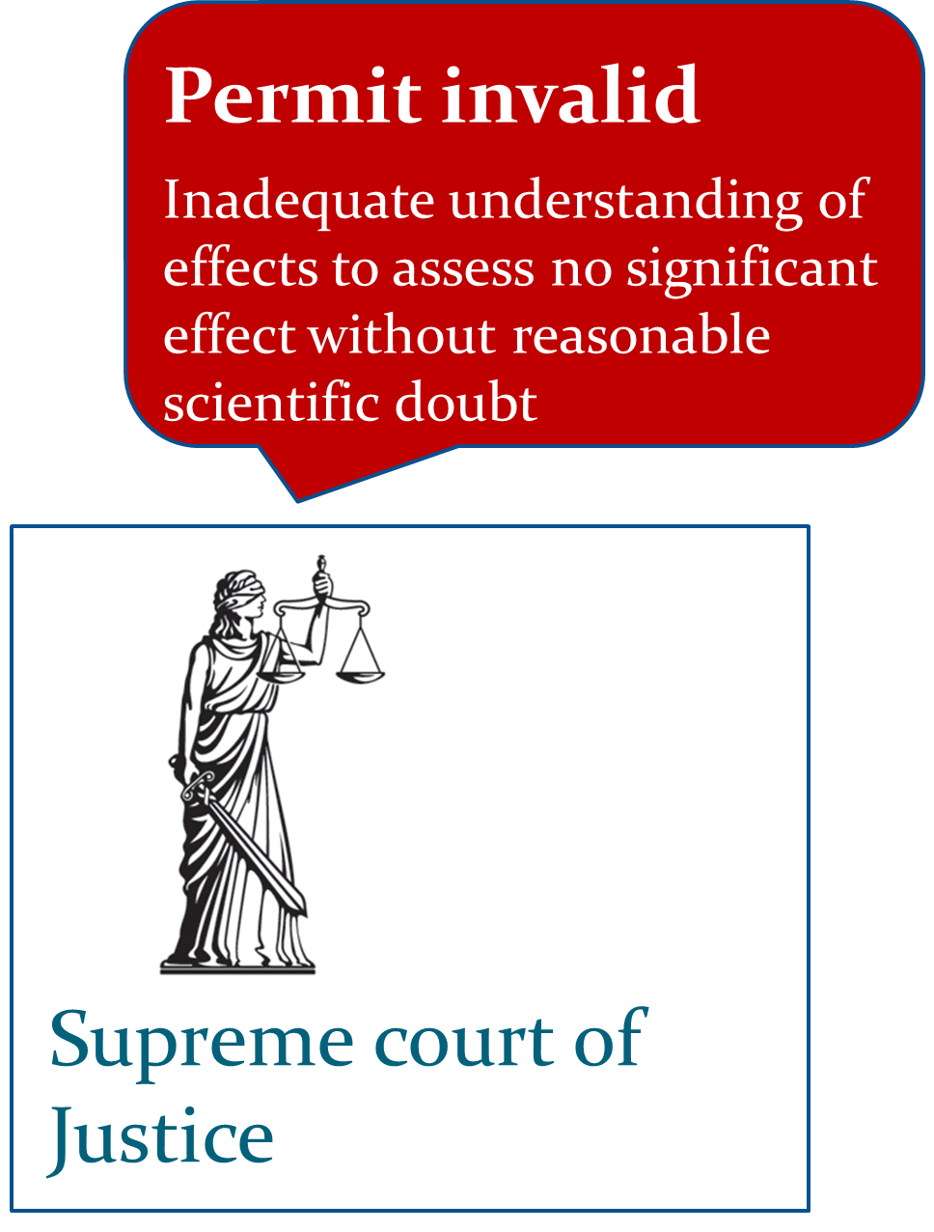
2008 Raad van State ruling
Mussel seed fishery
Mussel fishery belongs in the Wadden Sea
No damage to the seabed

Slide 14
A powerboat race in 2011
Powerboat race
Permit authority: Appropriate assessment insufficient, lack of data and ambiguity on small effects

Slide 15
Permit for a powerboat race in 2011
Powerboat race
No significant effect
Uncertainty of incomplete knowledge is addressed through monitoring
The Wadden Sea is not only for bird watchers
Possible significant effect
Uncertainty of incomplete knowledge of underwater noise and ambiguity on cumulation of effects
Power boat races don’t belong in the Wadden Sea

Slide 16
Ambiguity on cumulative effects
Powerboat race
No cumulative effects: Compared to 45.000 ship movements/year negligible
The Wadden Sea is not only for bird watchers
Possible cumulative effects: Incomplete knowledge of effects current use
Power boat races don’t belong in the Wadden Sea

Slide 17
Ambiguity on cumulative effects
Powerboat race
No cumulative effects: Assessed for sailing event
The Wadden Sea is not only for bird watchers
Possible cumulative effects: More activities with potential cumulative effects
Power boat races don’t belong in the Wadden Sea

Slide 18
Raad van State ruling
Powerboat race
Permit valid
Preliminary decision: no objective information that the assessment is incorrect
The Wadden Sea is not only for bird watchers
Power boat races don’t belong in the Wadden Sea

Slide 19
Conclusions on the science-policy boundary
Dominance of science-based experts to assess significant effect
Clear demarcation of role experts through contract research (problem of independency)
Shared responsibility to make the judgement of significance
In mussel case: claimed by permit authority
In powerboat case: pushed towards science-based experts
Floor et al. (2016) Environmental Science & Policy

Slide 20
Conclusion on dealing with uncertainty
With the technocratic approach of significant effect the value differences have not disappeared, but absorbed in scientific discussions
Not knowing enough
Knowing differently
Incomplete knowledge
Unpredictability
Ambiguity
Topic of debate
Driver of conflict
Floor et al. (2016) Environmental Science & Policy

Slide 21
Political aspects of cumulative effect assessments
Which potential effects are relevant?
Of which activities?
On which species and habitats?
Small effects negligible?
Who is making these decisions?
Responsibilities of initiators, scientists, government and interest groups
How to deal with uncertainty?
Incomplete knowledge, unpredictability, ambiguity
Precautionary principle or adaptive management?

Slide 22
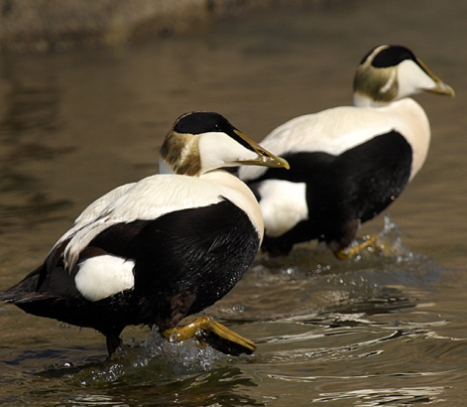
Thank you! Floor et al. (2016) Uncertainties in the assessment of “significant effect” on the Dutch Natura 2000 Wadden Sea site – The mussel seed fishery and powerboat race controversies
judith.floor@wur.nl

