Slide 1
WASS Peer Review
What are the next steps?
Alfons Oude Lansink

Slide 2
WASS Peer Review – Next Steps
16.00 Alfons Oude Lansink – WASS
16.20 Jack van der Vorst – SSG
16.30 Bram de Vos – ESG
16.40 Discussion
17.00 Drinks

Slide 3
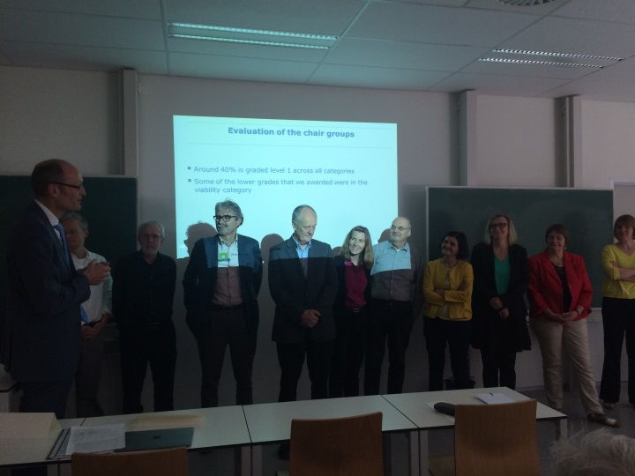
General Observations Committee
Impressed by the overall high quality of the research activities and output
Unique niche in life sciences; interdisciplinarity is a strength, which could be further exploited
Variation in group size and endowments

Slide 4
Quality in 2009 and 2015

Slide 5
Societal Relevance in 2009 and 2015

Slide 6
Viability in 2009 and 2015

Slide 7
Recommendations (1)
Enhance collaboration between groups
Interdisciplinarity – also pay attention to measuring output of interdisciplinary research
Common (WASS-wide) strategy
Actions:
Organize thematic meetings around e.g. investment themes Wageningen UR or newly emerging research domains, also to enhance external visibility WASS groups
Open call PhD projects – recently completed

Slide 8
Recommendations (2)
Provide more generic PhD training in:
Methods
Theory
Research design
Actions:
New education committee is going to develop a core curriculum for WASS PhD students
Institutional membership national networks
Increase PhD education budget? – PhD council investigates options for increasing the budget

Slide 9
Recommendations (3)
Uneven quality of supervision and PhD training across chair groups
Actions:
New WASS PhD core curriculum
Wageningen Graduate Schools initiated a working group which is going to come with recommendations to improve the supervision
Introduce a confidential section in the TSP (and digitalize the monitoring procedure).
Strengthen the instrument of the exit interview

Slide 10
Recommendations (4)
Critical mass and small group size: not just an issue of numbers. More important to mitigate less positive aspects of small group size
PhD training
External visibility
Actions:
Core curriculum WASS PhD
Thematic meetings around e.g. investment themes
Joint activities for WASS PhD students

Slide 11
Recommendations (5)
Greater monitoring in the area of PhD career prospects
More developed use of PhD alumni networks
Actions:
Include a section on career perspectives in the monitoring form - Role for supervisors!
Emphasis on career orientation in WASS core curriculum

Slide 12
Recommendations (6)
Monitor consequences of the university’s incentives to enhance research performance
Focus on research performance may discourage bottom up innovations which could lead to radical new insights
Interdisciplinary research and research in specific domains may not be well represented by existing bibliometric indicators.
Structured way of measuring societal impact and embed this in the strategy of the group
Action

Slide 13
WASS Peer Review
What are the next steps?
Jack van der Vorst – Director SSG

Slide 14
Director SSG/ESG– committee concludes ..
The capacity of WASS to ‘make a difference’ (both in academic and ‘relevance’ terms) is greatly increased by social science-wide collaboration and a shared strategic direction.
Specifically encourages a greater sense of interdisciplinarity and strategic development.
Directors of Science Groups (i.e. ESG and SSG) have a crucial role to play here and encourages their efforts in creating common purpose across the chair groups.
This is especially important when some chair groups demonstrate a tendency to conservatism in terms of their future plans and activities.

Slide 15
Director SSG/ESG– committee concludes ..
the budgetary system might offer disincentives to cooperation.
concerned that ‘impact’ seemed often to be driven by particular individuals rather than following a shared direction within and across chair groups.
maximum clarity in the specific and individual tenure track requirements so that the system is as predictable as possible.
emphasise the importance of succession planning within chair groups, the necessity for a strategic perspective on academic staffing, and the need for constant attention to academic recruitment processes in order to enhance quality across the groups.

Slide 16
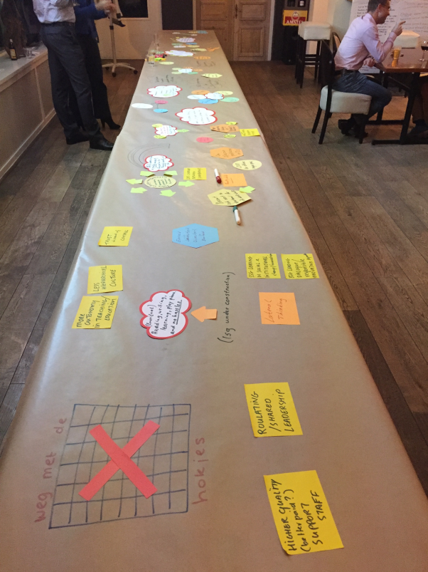
Heidag SSG – action plans
Robuuste leerstoelgroepen/financieringsmodel
Efficiënter en beter onderwijs met meer rust.
Meer transparantie in onderzoeksactiviteiten
Meer coördinatie in onderzoek
Investeringsthema’s
Centers
SSG thema’s
Evaluatie indeling secties
Meer eenheid en sprankeling hoe we ons naar buiten profileren, wie we zijn en wat we doen

Slide 17
WASS Peer Review
What are the next steps?
Bram de Vos – Director ESG

Slide 18
ESG – Considerations Bram de Vos (1)
Impressed by WAAS peer review score:
High Research Quality
High Impact scores
Some ESG Chair Groups improved!

Slide 19
ESG – Considerations Bram de Vos (2)
Vitality score peer review is not balanced:
Management of group?
Succession Chair holder?
Financial situation and future perspectives?
Large variation in financial status ESG Chair Groups
Too much effort (time) in education?
Chair Groups = Business Unit -> Collaboration?
Limited diversity in some Chair Groups:
Wageningen, Dutch, gender, competencies, ...?

Slide 20
ESG – Strategic Plan
ESG Strategic Plan:
Contributes to “One Wageningen”
University and Alterra
Research, Education, Stakeholders, People, Systems, Finance (“Strategic Scorecard”)
Collaborative, inclusive process is pivotal: buy-in!
Size of Chair Groups?
Tenure track: 3rd money flow?
WIMEK, PERC, WASS
Education Institute
...

Slide 21
Thank You!
Wageningen School
of Social Sciences

