Slide 1
Why the Productionist Model of Food Security Perversely Creates More Food-Poverty: (Ir)Responsible Innovation?
Brian Wynne,
Lancaster University
Public Lecture, Department of Communication, Philosophy and Technology, Wageningen University, 23rd May 2016

Slide 2
In this Talk…
The exclusively productionist model of the global food security ‘grand challenge’ is akin to the excusively risk-based model of governance for agricultural (bio)technologies
Why distribution is just as important – but also
How distribution processes and modes of production interconnect
Thus which mode of production is sustainable and just, also includes need for assessment of their corresponding mode of distribution
Including this omitted aspect means that increased aggreg. food production may still result in greater food poverty
In light of these observations: how should we think of RRI for ag and food, globally?

Slide 3
Some key distinctions – currently confused
Science for production (innovation, etc)
Science for protection (regulation, risk assessment, etc)
Science for public authority (advice for policy)
I suggest that science for protection (RA) is in practice framed and conducted so as to reinforce and protect what are currently IRresponsible modes of (productionist) research and innovation

Slide 4
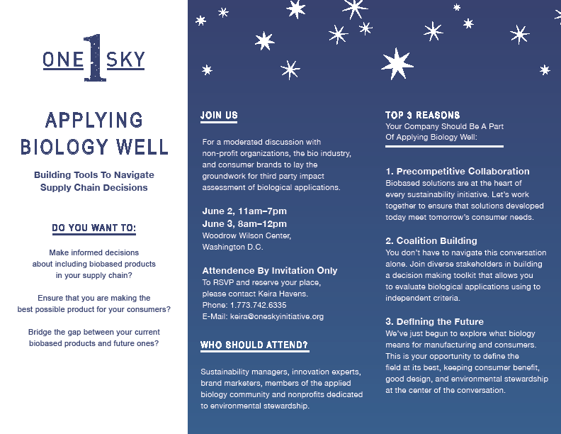
Some questions…
– I hope, constructive !

Slide 5
Risks and - possibilities… Research science and “sound science”
RISK – know harm, and know probabilities
UNCERTAINTIES – may know possible harm-effects, but don’t know probabilities
IGNORANCE – don’t know possible effects (don’t know which questions to ask: eg CFCs-strat. ozone)
AMBIGUITY – what is the meaning ? Framing? (eg, what are we trying to protect? from what?)
INDETERMINACIES - system complexities which escape repeatable deterministic control-prediction, even if known
A, Is and U are confused (by experts) with “Risk”
Research science may deal with U, I, A, but “science for policy” does not; it typically claims that risk knowledge covers all the questions

Slide 6
Alan Raybould, Syngenta, (Monday 6th Aug):
[for GM ERA] “if there is no plausible mechanism of harm, then uncertainty about the value [of a relevant parameter] does not imply uncertainty about the risk”
‘plausibility’ is strongly discipline-bounded (‘Science’ is not a unified culture). What accommodation is there of this? For example, multi-disciplinary, multi-experience, membership of expert RA committees?
In addition to the different dimensions outlined earlier, there are two different qualities to ‘uncertainty’ - epistemic; and ontological. The statement implies that no epistemic uncertainty is recognised.
Thus we need no reflection about possible knowledge-limits
(indeed it seems, this responsibility is not the applicants’ but policy’s - an unsound division of scientific labour)…

Slide 7
SCIENTIFIC IGNORANCE - DENIAL AND DELETION
“[ AEBC]: Do you think people are reasonable to have concerns about possible ‘unknown unknowns’ where GM plants are concerned?
[ACRE Chair]: Which unknowns?
[AEBC]: That’s precisely the point. They aren’t possible to specify in advance. Possibly they could be surprises arising from unforeseen synergistic effects, or from unanticipated social interventions. All people have to go on is analogous experience with other technologies.…
[ACRE]: I’m afraid it’s impossible for me to respond unless you
can give me a clear indication of the unknowns you are speaking about.
[AEBC]: In that case don’t you think you should add health warnings to the advice you’re giving ministers, indicating that there may be ‘unknown unknowns’ which you can’t address?
[ACRE]: No, as scientists, we have to be specific. We can’t proceed on the basis of imaginings from some fevered brow….”
AEBC public meeting, London, July 2001

Slide 8
Risk assessment’s political-epistemic limitation (by ‘policy’) does not just overlook and thus passively exclude by default important central political-economic concerns and dimensions. It actually proactively dictates their exclusion, and co-produces the political definition of the public issues as a risk-only issue
The US NAS report of last week has repeated once more this syndrome, as in the ex-EU chief scientific adviser’s public statement that EU and M-S governments should now allow GM cultivation

Slide 9
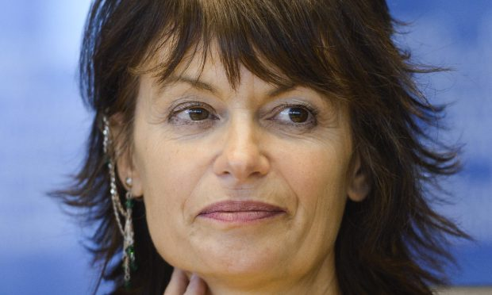
The Courier
Scotland’s farming industry has been urged by one of Europe’s most influential scientists to speak out and influence public opinion if it wants to have access to GM technology in future.
The former chief scientist to the EU, Professor Dame Anne Glover told members of the Scottish Society for Crop Research (SSCR) in Dundee that if they didn’t get the general public on side, the Scottish Government wouldn’t be interested in changing its anti-GM stance. Last week’s US National Academy of Sciences report has scientifically confirmed once again that GM crops and foods are safe, Prof Glover emphasised.

Slide 10
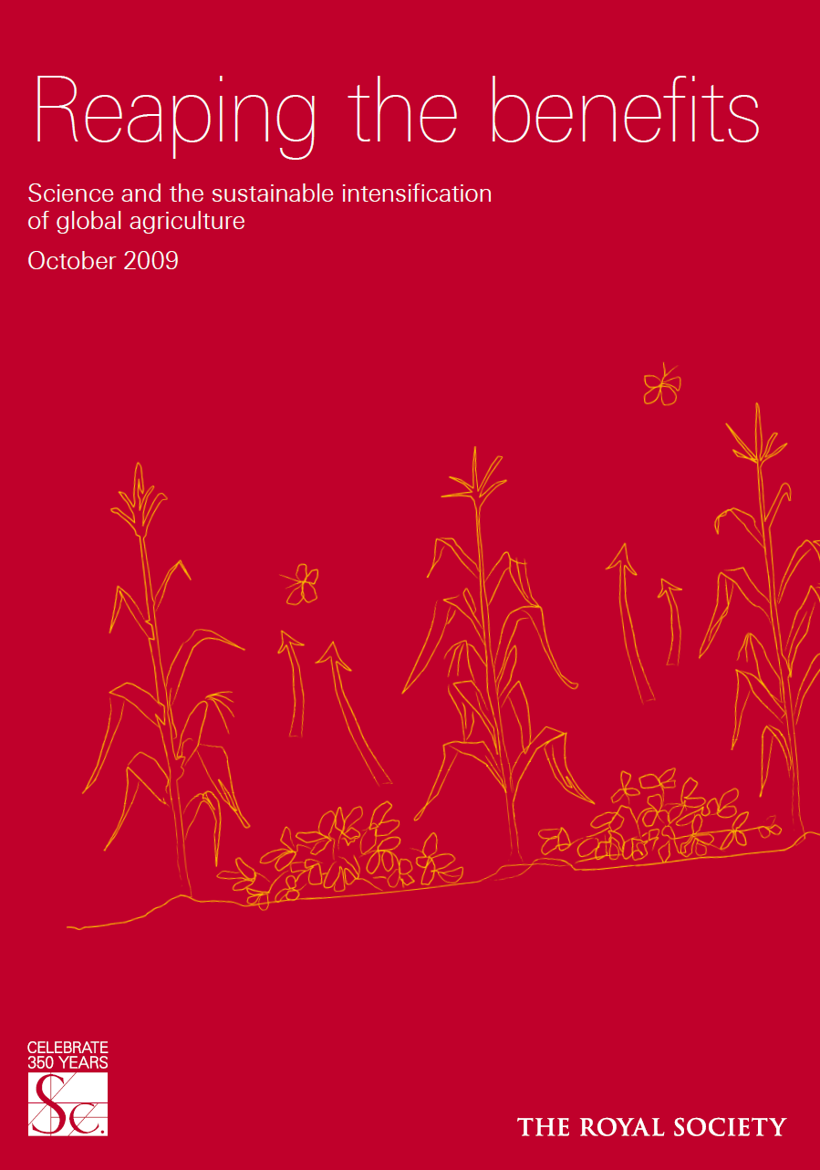

Slide 11
“There is a big gap between sophisticated UK laboratories and the reality of subsistence farming in Africa: to eliminate malnourishment requires an adequate economic and political infrastructure as well. But the message of this report is that scientific advances are necessary, even if they are not sufficient, if global food supplies are to be ensured” Martin Rees, Royal Society president, preface

Slide 12
Sustainable intensification?
“Food security is one of this century’s key global challenges. By 2050 the world will require increased crop production in order to feed its predicted 9 billion people. This must be done in the face of changing consumption patterns, the impacts of climate change and the growing scarcity of water and land. Crop production methods will also have to sustain the environment, preserve natural resources and support livelihoods of farmers and rural populations around the world. There is a pressing need for the ‘sustainable intensification’ of global agriculture in which yields are increased without adverse environmental impact and without the cultivation of more land”

Slide 13
The constraints on greater food production -
Population,
Land and water,
Seeds, and crop-germplasm diversity
Good soils
Knowledge – scientific and practical, situated
Control of pests, diseases, weeds
Climate stresses, various
Sovereignties – situated freedom (??)
“Maintaining and enhancing the diversity of crop genetic
resources is vital to facilitate crop breeding and thereby
enhance the resilience of food crop production” (CYMMIT; Svaalbard, chair of Global Crop Seed Diversity Trust, 2014)
Diversity is a very pregnant term here – biological? or also social?

Slide 14
Impacts ? ? (2)
Could we ever confidently claim to be able to enact the “right” societal impacts from ICTs? or social media? Or synthetic biology? Or nanotech?
How could we even identify these? – “jobs”…? “growth”…? (the usual mantra)
Or, “solving the Grand Challenges” for the EU?
A “Risk-based [impacts-predictive] approach” does not have to exclude all other factors (including benefits, and purposes, as questions) as it effectively does now. Nor should it perpetuate the predictive control myth
The EU Directive 2015/412 opens the ag innovation system to such broader factors than RA alone. But to aim for the sustainability impact of ag biodiversity needs more . This would need to develop a policy culture which addresses diverse innovation options

Slide 15
“Are We Ready for the Future of Food?”
Dror Berman and Samantha Wai, Innovation Enterprise
The World Post (Huff Post and the Berggruen Institute), 08/03/2016
“Regardless how we cut it, livestock production is process-inefficient.
Cattle in feed-lots need about seven kg of feed to produce just one kg of body weight. For pork, this ratio improves to about 4-to-1. For poultry, it's roughly 2-to-1.
But with all inefficient processes comes opportunity -- in this case, a moonshot opportunity to revolutionize thinking about food, resources, health, nutrition and planetary sustainability.
The food tech sector is exploding with startups, raising a record $5.7 billion in 2015 alone. Impossible Foods, and Ripple Foods, take a plant-based approach to recreating mainstream food like hamburgers and milk. Clara Foods is using synthetic biology to recreate egg white proteins through yeast. Memphis Meats and Modern Meadow have been building the tech. to produce animal products at scale by culturing meat cells in the laboratory”

Slide 16
“Are We Ready for the Future of Food?”
Dror Berman and Samantha Wai, Innovation Enterprise
The World Post (Huff Post and the Berggruen Institute), 08/03/2016
“Regardless how we cut it, livestock production is process-inefficient.
Cattle in feed-lots need about seven kg of feed to produce just one kg of body weight. For pork, this ratio improves to about 4-to-1. For poultry, it's roughly 2-to-1.
But with all inefficient processes comes opportunity -- in this case, a moonshot opportunity to revolutionize thinking about food, resources, health, nutrition and planetary sustainability.
The food tech sector is exploding with startups, raising a record $5.7 billion in 2015 alone. Impossible Foods, and Ripple Foods, take a plant-based approach to recreating mainstream food like hamburgers and milk. Clara Foods is using synthetic biology to recreate egg white proteins through yeast. Memphis Meats and Modern Meadow have been building the tech. to produce animal products at scale by culturing meat cells in the laboratory”

Slide 17
“It is clear that entrepreneurs and investors are excited to find alternative ways to support our growing global population. In particular, we see the latest innovations in synthetic biology, protein sequencing and tissue engineering opening doors to rethinking food and protein production.
Given this new ability to rethink food production, we at Innovation Endeavors were interested to see what consumers think about these new types of food products. We conducted an online consumer survey of people all over the U.S and got responses from 317 individuals. The survey asked respondents questions about their willingness to try new types of "tech-enabled" food products as well as about their criteria for food-purchasing decisions. Although limited in sample size, the survey reinforces three key lessons on the new food tech sector: what matters to consumers, how to most effectively get products to market and why these products can fill a demand that is currently underserved today.”

Slide 18
Three findings:
Create ingredients, not products (shield yourself from consumers and market reaction)
Go for ‘virgin markets’ (avoid competing vs entrenched consumer tastes)
Keep costs on a (long-term) downward trend

Slide 19
“Much of the latest food tech innovation centers around finding alternatives to animal-based products, with players focusing on how their products are better for the environment. For example, Modern Meadow talks about developing "cultured animal products without animal slaughter and much lower inputs of land, water, energy and chemicals." However, our survey indicates that "environmental sustainability" is not a priority for consumer food purchasing decisions. Achieving better nutrition, better taste and lower costs would be the ultimate trifecta. It's easiest to start with cost.
Due to the increasing demand for meat and the naturally low feed conversion efficiency of traditional animal production, economic and environmental costs of the current system will continue to rise. Simultaneously, the cost of technologies such as synthetic biology and tissue engineering are decreasing.”

Slide 20
Implied Message
Ethical bliss (no animal slaughter)
Global macro-meatification a natural demand-trend
Science-intensification effectively equals allowing externalisation of uncontrollable (unknown – ‘not our responsibility’) harms and costs
Default assumption that these innovations also embedded with - mutually reinforce - global political-economics of ‘food-security’

Slide 21
The World Economic Forum and Agriculture for Global food Security
2012, “A New Vision for Global Agriculture”
Sponsored by all the major global corporate ag-food-chemicals interests
Conducted-framed-promoted by McKinsey corp
Of course, “inclusive” project – yet “Stakeholders” do NOT include farmers !!!
In fact, by 2030, all small farmers globally will have been eradicated
And ‘democratic’ states integrated into the neo-liberal corporate regime

Slide 22
“Over the last three years, recognition that there are a limited number of quality seed and agricultural biotechnology assets, combined with many companies' desires to create pre-emptive positions, have resulted in a corporate gold rush to develop long-term strategic positions around broad agricultural biotechnology platforms. Major linkages of biotechnology assets and seed companies with leading agricultural chemical companies through strategic alliances and equity ownership positions, as well as outright acquisitions, have changed the corporate landscape of the seed, agricultural biotechnology, and crop protection industries almost overnight” Sano Shimoda, US Investment Banker, “Agricultural Biotechnology - Master Of The Universe?”, AgBioForum, 1(1), 1998, 62-68

Slide 23
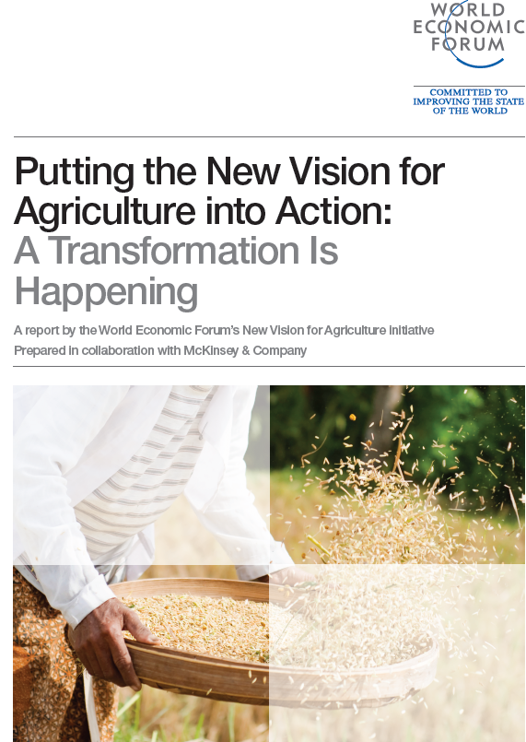

Slide 25
“Impacts” of this scenario?
Development through greater industrialisation of Indian agriculture (currently, ~97% of Indian farmers produce from <3 ha.), with 10s to 100s of millions migrating to already overloaded cities. That future for agriculture is unsustainable
Then Modi’s government promotes the Indian “Smart Cities” programme – to attract global capital investment (Harvey – “engines of growth, or engines of extraction?”)
Meanwhile Indian food production is increasingly integrated into global trading, where eg Cargill et al control commodity-trading, storage, transfer to already overfed rich consumer retail outlets, while local need is unmet – and farmers’ seed is controlled by global corporates’ monopolies. A/c to Stone, millions of tonnes of Indian cereal rot in stores awaiting global price rises, while millions of people starve in the same country.

Slide 26
“The Food System: A Major Economic Development Opportunity at a Time of Crisis
In the coming decades, a growing and increasingly affluent global population will demand a greater quantity, variety and nutritional value of food than the world has ever produced before. Meeting this demand will require a 70% increase in food production, challenging a natural resource base that is already under significant strain. It will also require major increases in investment – by up to 50% for developing countries alone – in an era of economic crisis and austerity.
Addressing these challenges effectively will require a New Vision for Agriculture – one which leverages available resources to deliver economic growth and opportunity, improved food security and nutrition, and environmental sustainability through a renewed agriculture sector.“
McKinsey and Co., World Economic Forum, Davos, 2012, A New Vision for Agriculture, p.2

Slide 27
[Needed - ]
“An investment and entrepreneurship pipeline:
Investment opportunities across the chain that drive farmer competitiveness and market linkages; populations of entrepreneurs, innovators and investors who can participate in the opportunities; and a transactional approach to kick-start investment” (p.5)

Slide 28
“The New Vision for Agriculture is one that reframes our view of the agriculture sector. Agriculture is a crucial driver of economic development. In establishing food security it raises productivity, incomes and employment, with broad effects across economic sectors.
The New Vision asserts that agriculture is a primary driver of economic growth, the planet’s largest source of potential for greenhouse gas (GHG) emissions abatement …
It represents a shift from approaching agricultural development with philanthropy to approaching it as a market investment, creating a system where stakeholders have the incentive to innovate, resilience to endure risk and capital to invest in growth” (p.5)

Slide 29
WEF 2012, New Vision for Global Agriculture report
“Stakeholders include all actors involved both directly in the food value chain and those impacting the broader food system, including: government, food and beverage companies; storage and processing firms; shipping and transport providers; retailers; IT; inputs companies; banks; and donor organizations”
– no farmers!!! ?? No other multifunctional land-users? (fn7, p.9)

Slide 30
McKinsey WEF “New Vision for Agriculture” report, 2012: the funders
“The New Vision for Agriculture initiative is led by 26 global Partner companies that span the full food value chain and beyond, including: AgCo, Archer Daniels Midland, BASF, Bayer CropScience, Bunge, The Coca-Cola Company, Diageo, DuPont, General Mills, Heineken, Kraft Foods, Metro, Monsanto Company, Maersk, Mosaic, Nestlé, PepsiCo, Rabobank International, SABMiller, Swiss Re, Syngenta, Teck Resources, Unilever, Vodafone, Wal-Mart Stores and Yara International. Each of these companies has contributed tremendous leadership and technical expertise…” (preface: Archer Daniels Midland and Bunge are two of the global giants in global grain trading)

Slide 31
Public sector should . . .
Create an enabling environment for market-driven economic growth & investment
Present attractive investment options to the private sector and donors
________________________________________________________________________
__________________________________________________________________________________
Adapt commercial models to fit the unique needs of developing country contexts
Demonstrate genuine commitment to a combined commercial & social value to earn trust & credibility (WEF 2012, 20)
Private Sector Should . . .

Slide 32
Greater Food Production? Greater Food Security?
The WEF corporate model posits industrialised high-input (unsustainable), high impact (soil infertility, water-stress, > herbicide-resistance, yield-drop) as ‘the only way’
Yet even if it did increase global food production, would it increase global food access?
Every reason to think not, since this model increases the control over production by global ‘free-market’ commodity-traders and speculators, global processors and retailers, oriented to rich-world (obesity-afflicted) consumers
This is why as Glenn Stone has described already, millions of people in India can starve, as millions of te of grain rot in storage awaiting better commodity-prices in Chicago, or are exported to those global markets rather than locally distributed
Everything in the New Vision of WEF and its corporate sponsors reflects this imaginary – and it is in material process.
“Science” – both in its innovation/productive mode, and in its ‘protective’ mode (RA, etc) – is locked into this political economy, and indeed reinforces it with scientific authority, through bodies like EFSA, USEPA, and so on

Slide 33
The fuller frame for global GM
GM involves concentration of ownership-control of key elements of global food chain, including land, + direct socioeconomic effects
Biosafety or RA excludes any of this, in policy
Policy parrots commercial interests in insisting “GM is a scientific issue (only)” (biosafety, RA)
But then invests huge resources in controlling the ensuing scientific debate (Seralini, one eg; several more…)
So, political control of technology and alternative innovation-directions Qs are denied, and biosafety declared a non-issue, “already resolved by science”.
This scientism conceals and defends a huge global political economy, including but not only science, and science in both production and protection modes
Ideological coercion by the state, supports neolib corporate agenda

Slide 34
‘Causes’, and ‘Impacts’ ?
How can ‘procedural’ approaches to RRI (as distinct from ‘outcomes’ or ‘impacts’ approaches) address the political-economic forces in play which shape and indeed dominate research and innovation?
If this is a longer-term democratic and moral struggle than a set of technical ones alone, what kinds of ‘technical’ action might initiate this?
The (EU) “Grand Challenges” approach – “meeting societal needs”: but when ‘responsible’ innovation is then effectively defined as anything which allows qualified private-corporate interests to gain markets by commodifying social processes-relations which maybe need not to be commodified, for meeting those “grand challenges”….? ? ?
A self-reinforcing political system of ‘technoscience-defined’ RRI

Slide 35
A Key Question for RRI
Who are, or should be, the responsible agents of Responsible Research and Innovation?
Governments (‘policy-makers’)?
regulators (RA experts)?
Scientists (researchers? Research-funders?)?
Entrepreneurs?
Corporations?
Investors?
Consumers?
Citizens?
NGOs?
All, or which combinations, of these ?!
Put this way, we can see “RRI” as a collective political-technical heuristic. Its ambiguity can be a vital strength, and not just a fatal weakness. We also have responsibility…

Slide 36
Dewey on (Diffuse) Collective Agency
“That character of everyday experience which has been most systematically ignored by philosophy is the extent to which it is saturated with the results of [incessant] social intercourse and communication.
Because this factor has been denied, meanings have either been denied all objective validity, or have been treated as miraculous extra-natural intrusions. If, however, language, for example, is recognized as the instrument of social cooperation and mutual participation, continuity is established between natural events (animal sound, cries, etc.) and the origin and development of meanings. Mind is seen to be a function of social interactions, and to be a genuine character of natural events when these attain the stage of widest and most complex interaction with one-another.” [relationality] John Dewey, Experience and Nature ,1929
What does this say for agency in RRI ? One key answer is the pervasively social, mutual and diffused character of such responsibility. Also recall the “implementation-gaps” of policy (Sabatier et al, Hawkins, Wildavsky..). ‘deficits’? - or normal complexities where policy aims were unrealistically ambitious thus impossible?

Slide 37
A(nother) Grand Challenge….
So, why could policy not develop new relationships, new ‘stakeholders’, not the usual suspects or imagined users, for innovation-actors, including their investors ? With an inadequate vision of publics and citizens, RRI is impossible
This would also require new cultures of listening to those different stakeholders’ needs, their priorities, their imagined futures and aspirations, and their conditions
The EU Grand Challenges approach could do this - but so far that remains somewhere lost in the undergrowth
Gunnarsdottir, 2013: “in practice the H2020 programme translates into innovation only when this is of a form which makes markets for the big corporate partners of the EC funding machinery” – true for food security as other areas

Slide 38
For Food Security as a Grand Challenge
As Altieri and many others, including the UN IAASTD report have noted, small farmers and agroecological methods produce ~ 70% of the world’s food. This vast distributed population of knowledge-actors could be included collectively as stakeholder for informing scientific research for global food and agric.
The WEF 2012 report inter alia demonstrates, it is currently virtually totally excluded.
This does not have to be
New stakeholders are not the same as ‘public engagements’

Slide 39
Macnaghten’s Metis (of RRI)
The A I R R framework
Von Schomberg’s (EC) “right impacts” as RRI aim
RRI as a latest form of TA?
“Metis” more practical savvy, less formal models
Purposes-focused as well as ‘impacts’…
(needs imaginaries in conceptual kit therefore)
- where are “the roads not taken” ???
And how can we (analysts, policy) interpret public concerns (from qual. social research) into new (or marginalised) trajectories?

Slide 40
“Metis” more practical savvy, less formal models
Purposes-focused (futures) as well as ‘impacts’…
(but needs imaginaries in conceptual kit therefore)
But a Q for RRI - where are “the roads not taken” ??? (eg, GMOs: Vanloqueren and Baret, 2009) - STEPS 3D here?
And how can we (analysts, policy) interpret public concerns (from qual. social research…) into new (or so-far marginalised) innovation trajectories?
Political economy also necessary (see WEF 2012; defensive mode of RA in regulation/policy, eg DG SANTE-EFSA) …
…along with overt scientific and policy acceptance of ignorance, contingency, conditionality (the – denied - epistemic other of scientific risk assessment).
It is not only policy-advisory science which refuses this – also “democratic” politics, in mutual reinforcement

Slide 41
Metis of RRI.. (continued)
(Future-oriented) Care and responsibility within science, for beyond science;
But too much respect for science dangerous here, even with a “Prospective model of responsibility” (Metis paper, p.3) – because if we start from “scientific peer-review” for what is deemed possible, we inadvertently restrict innovation to what is a closed world of scientific imagination not only of the technical, but also of the social and political. Kuhn pointed out the dogmatic quality of those worlds, and others have since noted their normative character too, as science goes public (including with public engagement, + maybe RRI).

Slide 42
Like Phil, I have paid compliments to the UK EPSRC for its serious commitments to developing RRI for its R&D investments of UK public money - and in some respects to BBSRC too. But this is so-far a bridge not crossed – to venture into the internal worlds of technoscientific cultures (including their completely interwoven prospective funding cultures) to question those imaginaries of future tractable possibilities, and “desirables”. These are influenced not only by technical fluencies, but also by socio-political imaginations and normativities of those involved. The ASU Fisher et al STIR project might be the most developed STS mode for exploring this.

Slide 43
Metis of RRI
The governance of global agbiotech, and RRI
Phil’s Durham University Templeton project demonstrated how the North-world problem of exclusive risk-centredness of governance is also entrenched in the global South – Mexico, India, Brazil.
But it is not only that this framework ignores the poor’s needs/concerns – it erases them
Thus the same governance system presumptively defines their knowledge, their culture, their land as resources for expropriation - and deletion

Slide 44
“Consensus Science” – A Perspective
“Consensus Science and the Peer Review” – Editorial
Jorge R. Barrio, Editor-in-Chief, Molecular Imaging and Biology (peer reviewed scientific journal), April 28, 2009
“I am quite certain that most of us have been – in one way or another - exposed to the concept (and consequences) of ‘consensus science’. In fact, scientific reviewers of journal articles or grant applications – typically in biomedical research - may use the term (e.g., ‘….it is the consensus in the field…’) often as a justification for shutting down ideas not associated with their beliefs.”
“…Michael Crichton explains it the best when he said ‘I regard consensus science as an extremely pernicious development that ought to be stopped cold in its tracks. Historically, the claim of consensus has been the first refuge of scoundrels;
it is a way to avoid debate by claiming that the matter is already settled. Whenever you hear the consensus of scientists agrees on something or other, reach for your wallet, because you’re being had… Let’s be clear: the work of science has nothing whatever to do with consensus. Consensus is the
business of politics. Science, on the contrary, requires only one investigator who happens to be right, which means that he or she has results that are verifiable
by reference to the real world. In science consensus is irrelevant. What are relevant are reproducible results.’ ” (Note: underlined words have been added for emphasis) (Michael Crichton - physician, producer, and writer – Lecture,
California Institute of Technology, January 17, 2003)

